Slide 1


Adaptive Checkpoint Adjoint Method for Gradient Estimation in Neural ODE
Juntang Zhuang, Nicha C. Dvornek, Xiaoxiao Li, Sekhar Tatikonda, Xenophon Papademetris, James Duncan
Yale University

Slide 2
Background
Neural ordinary differential equation (NODE) is a continuous-depth model, and parameterizes the derivative of hidden states with a neural network. (Chen et al., 2018)
NODE achieves great success in free-form reversible generative models (Grathwohl et al., 2018), time series analysis (Rubanova et al., 2019)
However, on benchmark tasks such as image classification, the empirical performance of NODE is significantly inferior to state-of-the-art discrete-layer models (Dupont et al., 2019; Gholami et al., 2019).
We identify the problem is numerical error of gradient estimation for continuous models, and propose a new method for accurate gradient estimation in NODE.

Slide 3
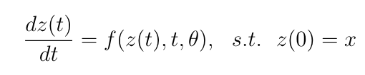
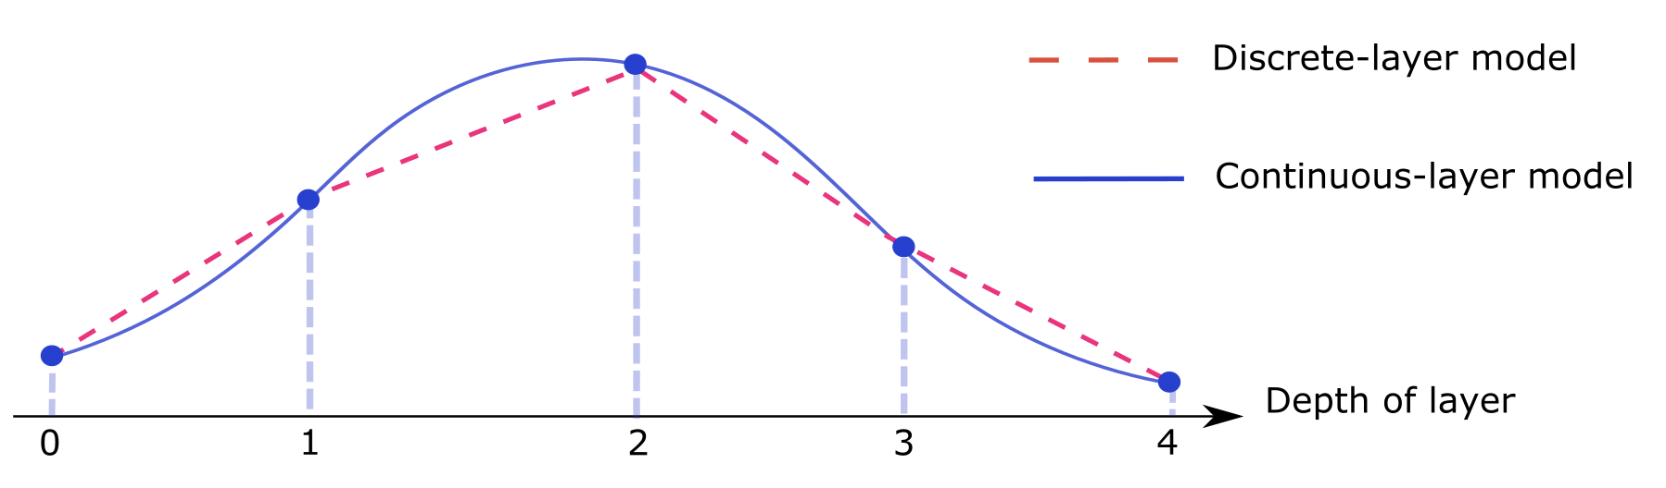
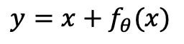
Recap: from discrete-layer ResNet to Neural ODE
Discrete-layer ResNet
Continuous-layer model
$$y=x+f_{θ}(x)$$
We call $t$ “continuous depth” or “continuous time” interchangeably.
Chen, Tian Qi, et al. "Neural ordinary differential equations." Advances in neural information processing systems. 2018.

Slide 4
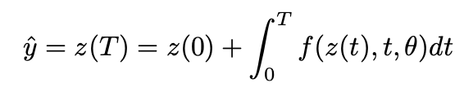
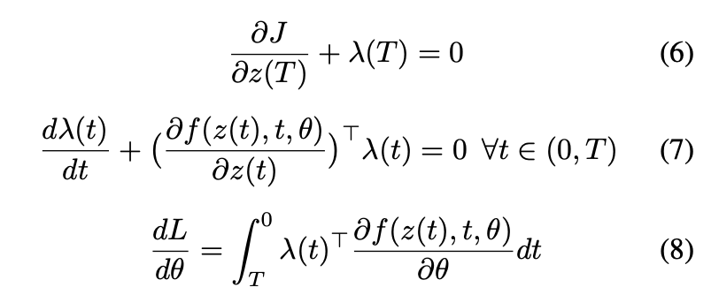
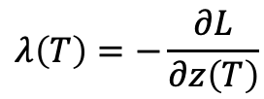
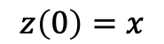
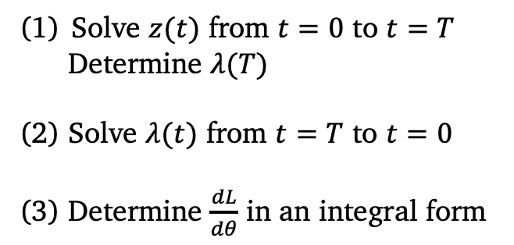
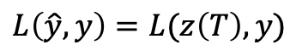
Forward pass of an ODE
Input:
$$z\left(0\right)=x$$
Output:
Loss:
$$L\left(\hat{y},y\right)=L(z\left(T\right),y)$$
Analytical form of adjoint method to determine grad w.r.t. $θ$
Solve $z(t)$ from $t=0$ to $t=T$
Determine $λ(T)$
(2) Solve $λ(t)$ from $t=T$ to $t=0$
(3) Determine $\frac{dL}{dθ}$ in an integral form
$$λ\left(T\right)=−\frac{∂L}{∂z\left(T\right)}$$
Pontryagin, L. S. Mathematical theory of optimal processes. Routledge, 1962.

Slide 5
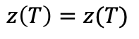
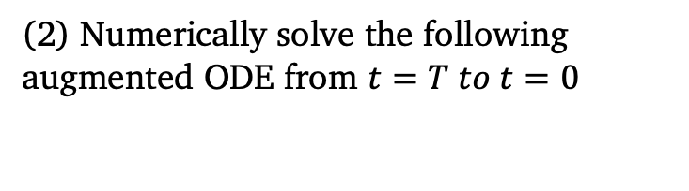
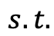
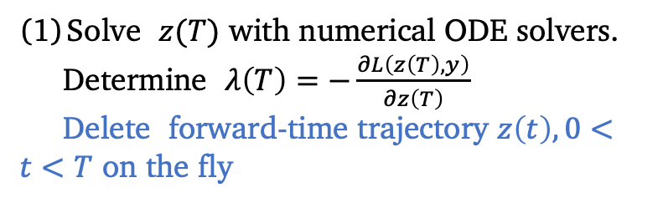
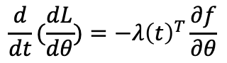
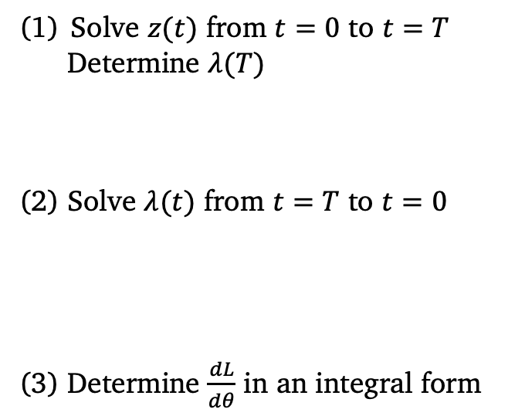
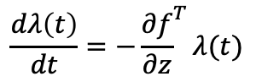
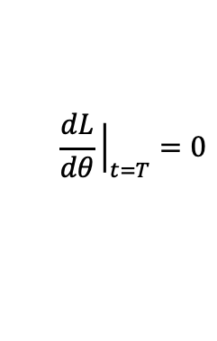
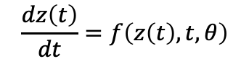
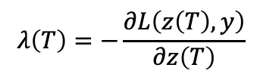
Numerical implementation of the adjoint method
Analytical Form
Numerical implementation
Solve $z(t)$ from $t=0$ to $t=T$
Determine $λ(T)$
(2) Solve $λ(t)$ from $t=T$ to $t=0$
(3) Determine $\frac{dL}{dθ}$ in an integral form
Solve $z(T)$ with numerical ODE solvers.
Determine $λ\left(T\right)=−\frac{∂L\left(z\left(T\right),y\right)}{∂z\left(T\right)}$
Delete forward-time trajectory $z\left(t\right), 0<t<T$ on the fly
Forward-time
(2) Numerically solve the following augmented ODE from $t=T to t=0$
Reverse-time
$$\frac{dz\left(t\right)}{dt}=f\left(z\left(t\right),t,θ\right)$$
$$z\left(T\right)=z(T)$$
$$\frac{dλ\left(t\right)}{dt}=−{\frac{∂f}{∂z}}^{T}λ(t)$$
$$λ\left(T\right)=−\frac{∂L\left(z\left(T\right),y\right)}{∂z\left(T\right)}$$
$$s.t.$$
$$\frac{d}{dt}(\frac{dL}{dθ})=−λ{\left(t\right)}^{T}\frac{∂f}{∂θ}$$
$$\frac{dL}{dθ}{\left.​\right|}_{t=T}=0$$
Solve augmented ODE in reverse-time
Chen, Tian Qi, et al. "Neural ordinary differential equations." Advances in neural information processing systems. 2018.

Slide 6
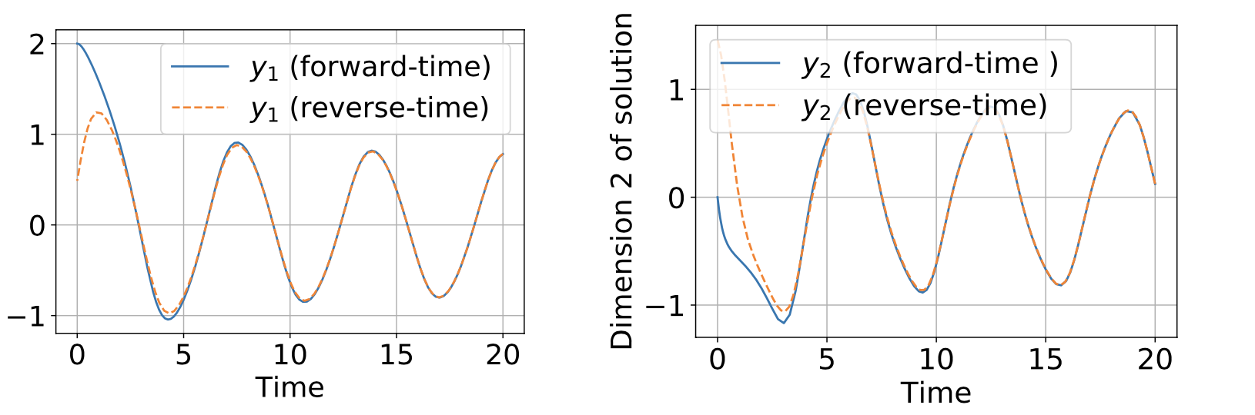
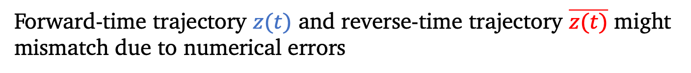
Forward-time trajectory $z(t)$ and reverse-time trajectory $\overline{z(t)}$ might mismatch due to numerical errors
Experiment with van der Pol equation, using ode45 solver in MATLAB

Slide 7
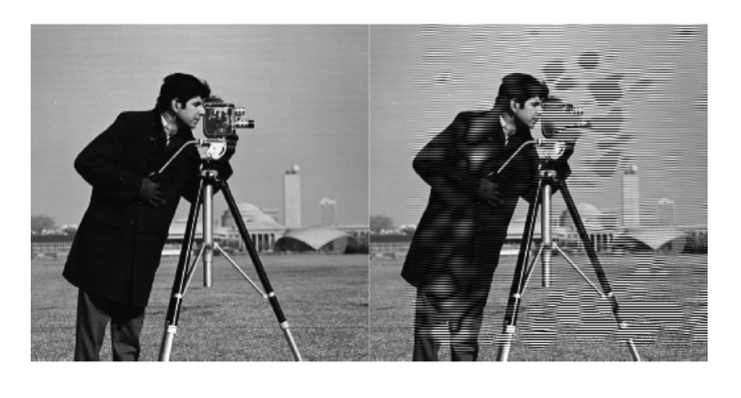
Forward-time trajectory $z(t)$ and reverse-time trajectory $\overline{z(t)}$ might mismatch due to numerical errors
Experiment with an ODE defined by convolution, using ode45 solver in MATLAB
Input
Reverse-time reconstruction

Slide 8
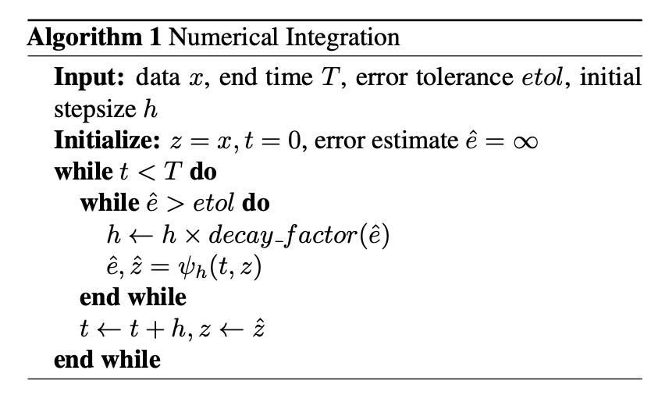
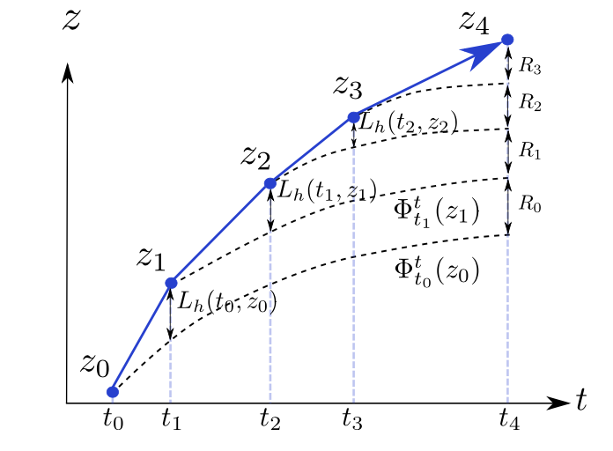
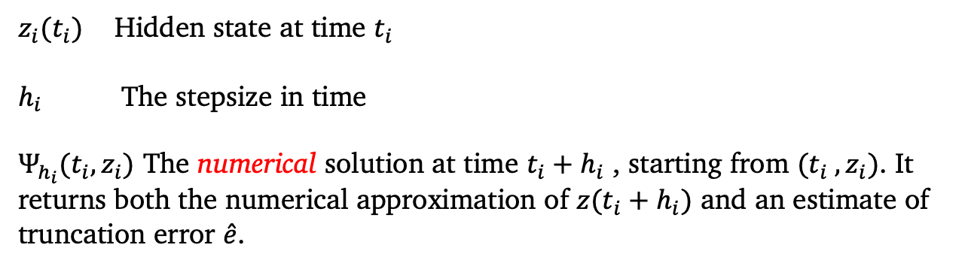
Recap: Numerical ODE solvers with adaptive stepsize
$z_{i}(t_{i})$ Hidden state at time $t_{i}$
$h_{i}$ The stepsize in time
$Ψ_{h_{i}}(t_{i}, z_{i})$ The numerical solution at time $t_{i}+h_{i}$ , starting from $(t_{i} , z_{i})$. It returns both the numerical approximation of $z(t_{i}+h_{i})$ and an estimate of truncation error $\hat{e}$.

Slide 9
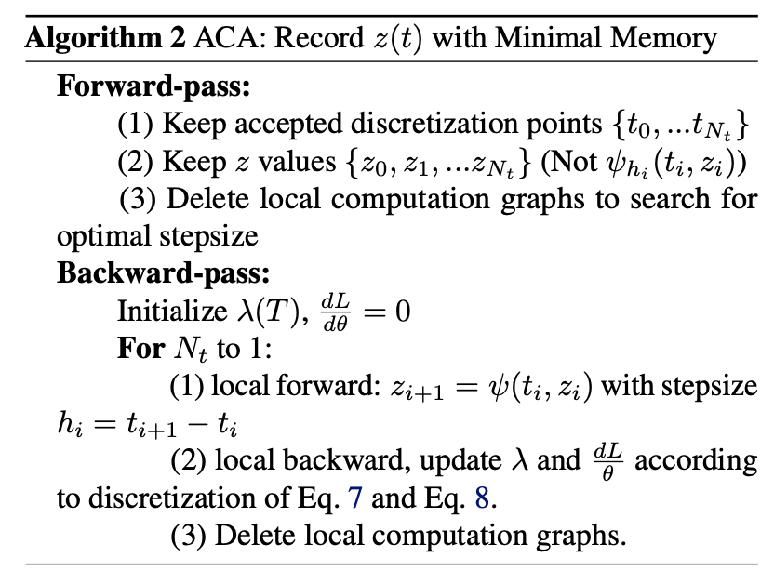
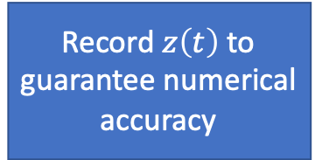
Adaptive checkpoint adjoint (ACA) method
Record $z\left(t\right)$ to guarantee numerical accuracy
Delete redundant computation graph and recollect memory
adjoint equations

Slide 10
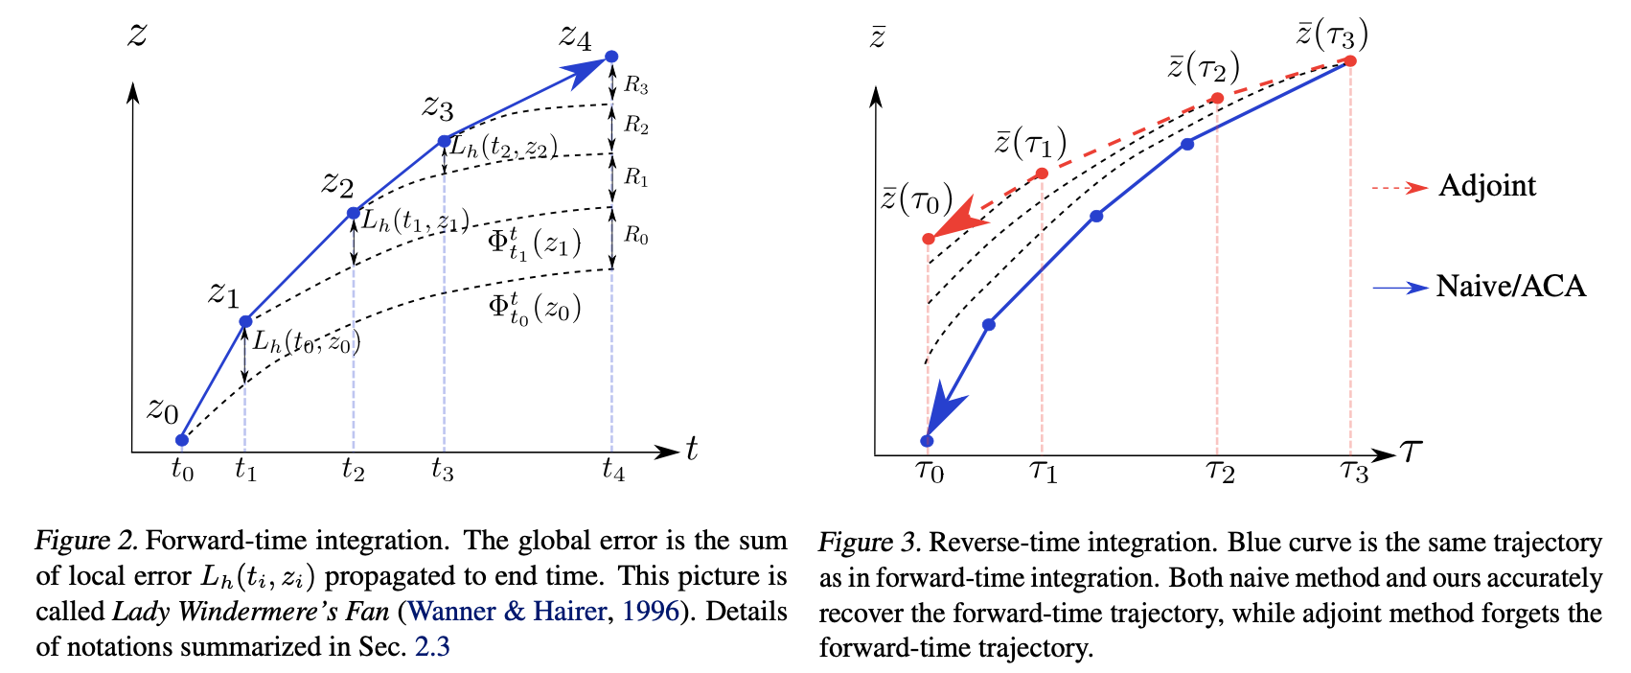
Comparison of different methods
Forward-time trajectory
Reverse-time trajectory

Slide 11
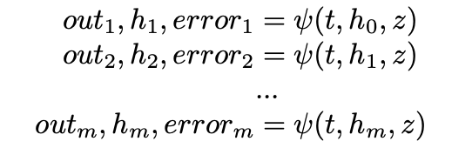
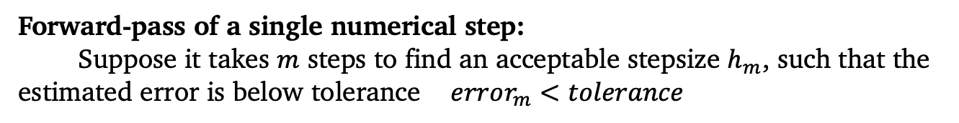
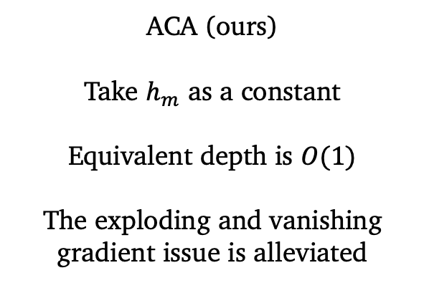
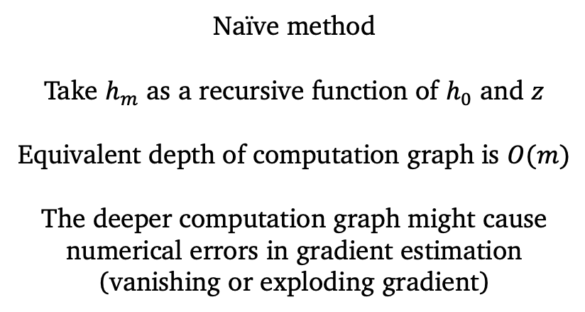
Comparison with naïve method (direct back-prop through ODE solver)
Forward-pass of a single numerical step:
Suppose it takes $m$ steps to find an acceptable stepsize $h_{m}$, such that the estimated error is below tolerance $error_{m}<tolerance$
Backward-pass of a single numerical step:
Naïve method
Take $h_{m}$ as a recursive function of $h_{0}$ and $z$
Equivalent depth of computation graph is $O(m)$
The deeper computation graph might cause numerical errors in gradient estimation (vanishing or exploding gradient)
ACA (ours)
Take $h_{m}$ as a constant
Equivalent depth is $O(1)$
The exploding and vanishing gradient issue is alleviated

Slide 12
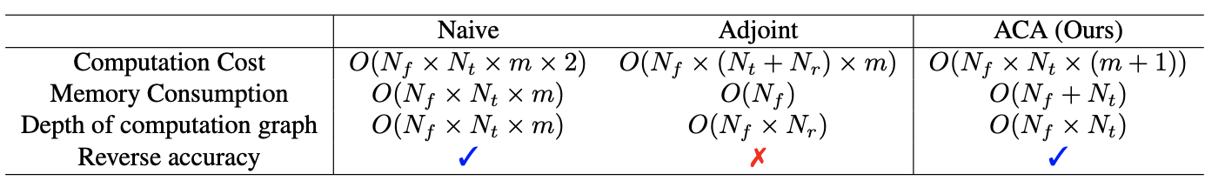
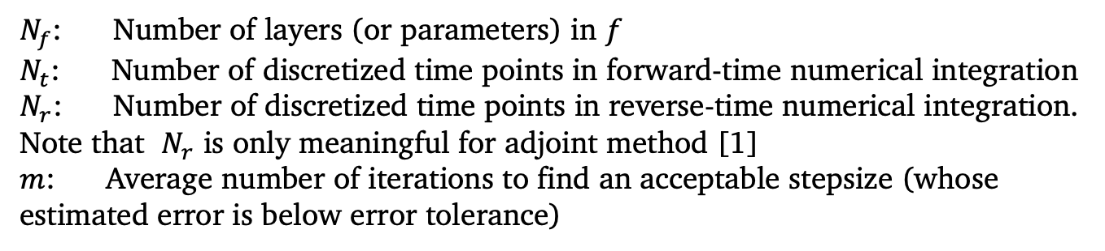
Comparison of different methods
[1]
$N_{f}$: Number of layers (or parameters) in $f$
$N_{t}$: Number of discretized time points in forward-time numerical integration
$N_{r}$: Number of discretized time points in reverse-time numerical integration. Note that $N_{r}$ is only meaningful for adjoint method [1]
$m$: Average number of iterations to find an acceptable stepsize (whose estimated error is below error tolerance)
[1] Chen, Tian Qi, et al. "Neural ordinary differential equations." Advances in neural information processing systems. 2018.

Slide 13
Comparison of different methods
[1]
Take-home message:
Compare with adjoint method, ACA guarantees the accuracy of reverse-time trajectory.
Compared with naïve method, ACA has a shallower computation graph, hence is more robust to vanishing and exploding gradient issue.
[1] Chen, Tian Qi, et al. "Neural ordinary differential equations." Advances in neural information processing systems. 2018.

Slide 14
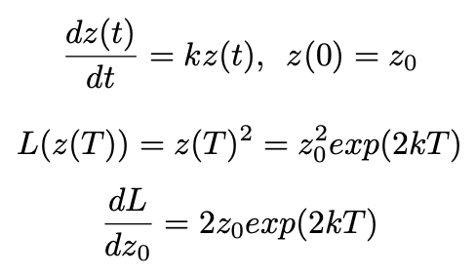
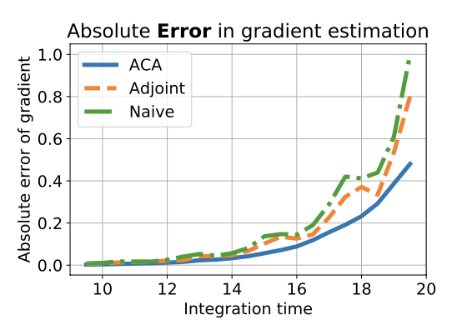
Comparison of different methods
Consider a toy example whose gradient can be analytically solved

Slide 15
Experimental results

Slide 16
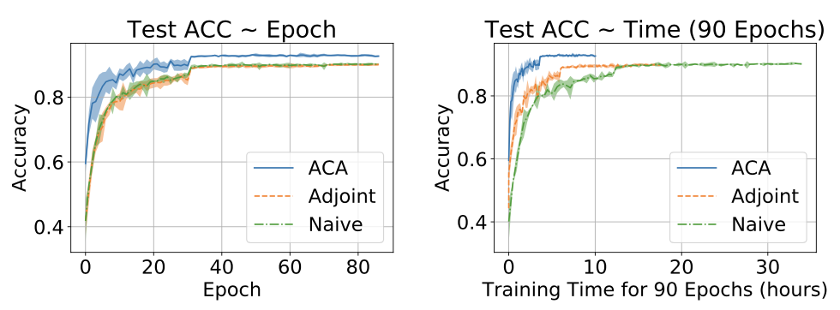
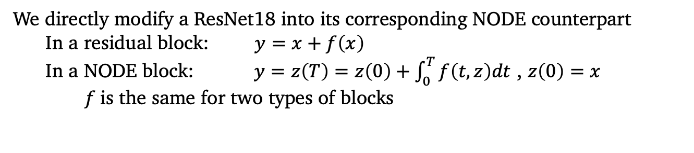
Supervised image classification
We directly modify a ResNet18 into its corresponding NODE counterpart
In a residual block: $y=x+f\left(x\right)$
In a NODE block: $y=z\left(T\right)=z\left(0\right)+\int_{0}^{T}{f\left(t,z\right)dt}$ , $z\left(0\right)=x$
$f$is the same for two types of blocks
Performance of NODE trained with different methods

Slide 17
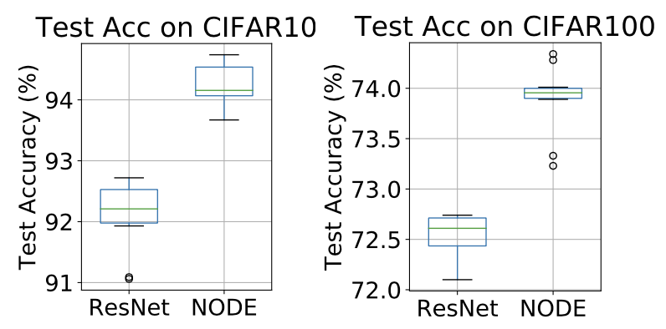
Supervised image classification
Comparison between ResNet18 and NODE-18 on Cifar10 and Cifar100. We report the results of 10 runs for each model.
Code for ResNet is from: https://github.com/kuangliu/pytorch-cifar

Slide 18
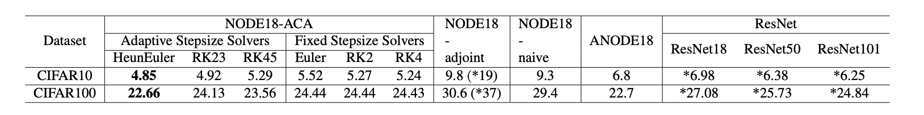
Supervised image classification
Error rate on test set of Cifar10
Results reported in the literature are marked with *
We trained a NODE18 with ACA and Heun-Euler ODE solver.
NODE-ACA generates the best overall performance
(NODE-18 outperforms ResNet-101).
NODE is robust to ODE solvers. During test, we used different ODE solvers without re-training, and still achieve comparable results

Slide 19
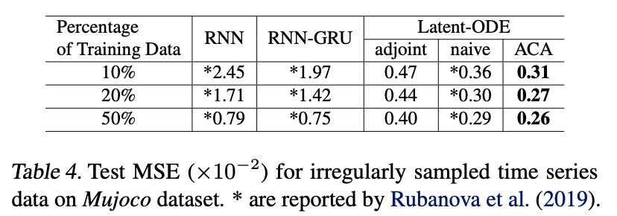
Time series modeling for irregularly sampled data

Slide 20
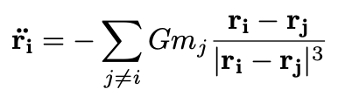
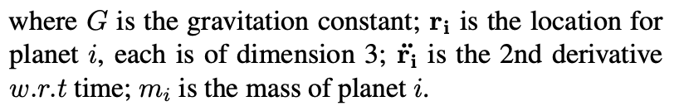
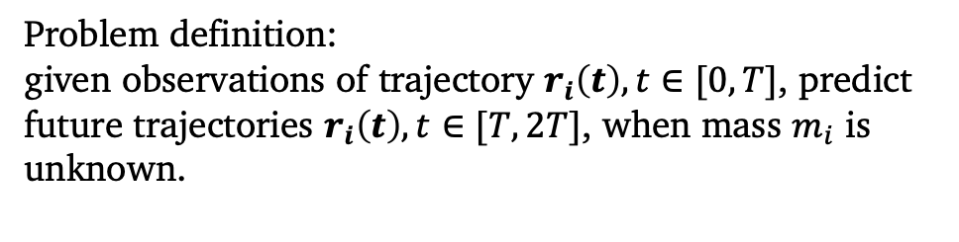
Incorporate physical knowledge into modeling
Three-body problem:
Consider three planets (simplified as ideal mass points) interacting with each other, according to Newton’s law of motion and Newton’s law of universal gravitation (Newton, 1833).
Problem definition:
given observations of trajectory $r_{i}\left(t\right), t∈[0,T]$, predict future trajectories $r_{i}\left(t\right), t∈[T, 2T]$, when mass $m_{i}$ is unknown.

Slide 21
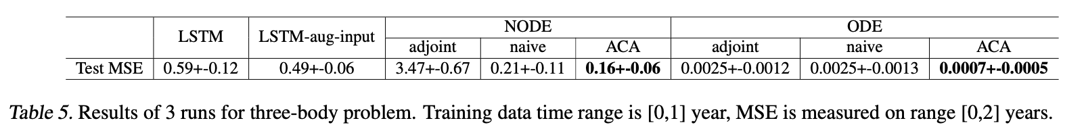
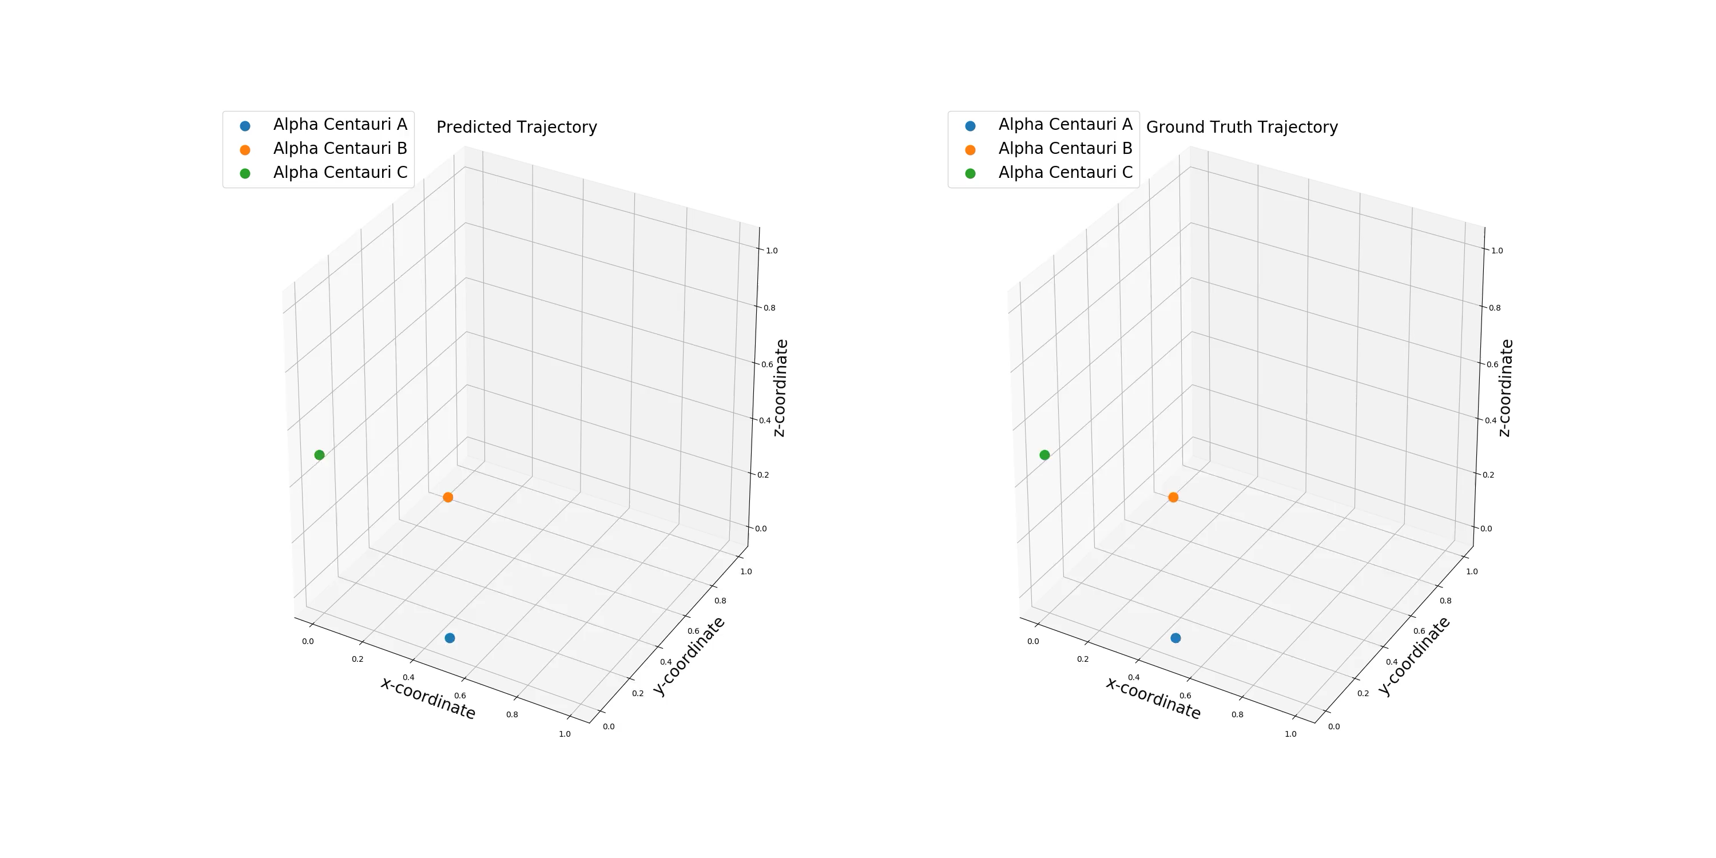
Incorporate physical knowledge into modeling
Predicted Trajectory
Ground-truth

Slide 22
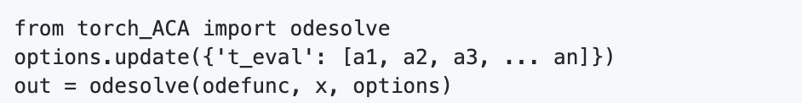
Conclusions
We identify the numerical error with adjoint method to train NODE.
We propose Adaptive Checkpoint Adjoint to accurately estimate the gradient in NODE.
In experiments, we demonstrate NODE training with ACA is both fast and accurate. To our knowledge, it’s the first time for NODE to achieve ResNet-level accuracy on image classification.
We provide a PyTorch package https://github.com/juntang-zhuang/torch_ACA, which can be easily plugged into existing models, with support for multi-GPU training and higher-order derivative.
(Reach out by email: j.zhuang@yale.edu or twitter: JuntangZhuang)

